Slide 1

Who am I?

Slide 2
Plans
Horizonal mechanic - Dash
Vertical mechanic – Wall climb
Extra physics mechanic – Rocket Jump
Notes:
For this project what I had in mind were a Dash, Wall climb and rocket jump
I chose these set of mechanics to work on since they aligned the best with a personal project that I’ve been working on and want to learn more about it so I can better my work and directly implement it into my game.

Slide 3
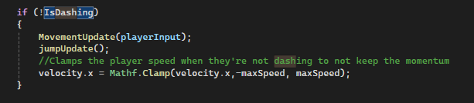
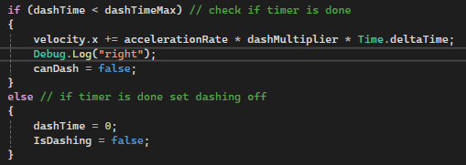
Horizonal mechanic Dash
Notes:
For the dash the player when they press the shift key they will be launched in the direction they are facing and will dash for a determined amount of time, For example if the dashTimeMax is 3 seconds the player will dash for 3 seconds before stopping

Slide 4
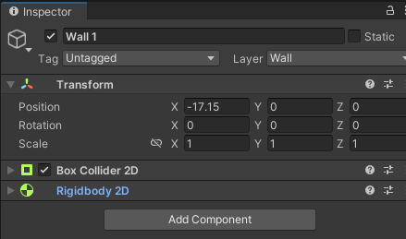
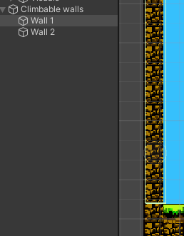
Vertical mechanic Wall climb
Notes:
For this one when a player starts climbing the wall they're going to check for layer named walls. If the player touches an object that has the layer walls attached to it they can press W key to start climbing up or press the S key to start climbing down. A good work around that I did for this one is that the size of of the map that are the walls they have an invisible object if a collider and the object itself is in the layer wow that I did this place so that I can check for the layer wall since the walls of this of this map already on the ground layer I couldn't check I couldn't check for the layer without the new colliders.

Slide 5
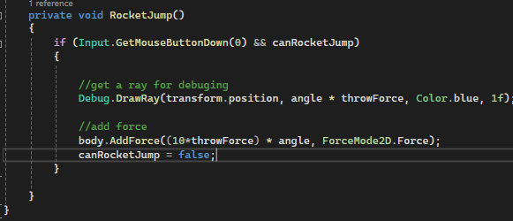
Extra physics mechanic Rocket Jump
Notes:
For the extra physics mechanic I did a rocket jumping so it works by first getting the players Mouse position transforming that into a direction and then I I turn into the opposite value so I grabbed this opposite value and I throw it and to the add force as its direction vector and apply the force so that way it launches a player in the opposite direction that the mouse is pointing the player Kind of like recoil

Slide 6
Changes made
Notes:
So for the testing on week 13 everything for mostly went well the things that I needed to add were where minor tweaks to the mechanics that I implemented so that they would feel better so for example my dash would keep the momentum even after dashing that way he made it that feel longer than it actually is my Rocket Jump didn't have a cool down so that it will be able and the variable for Speed on wall climbing was too low so it looks like the player was not climbing at all. Apart for the minor fixing I just need to introduce components that we did in class such as terminal velocity and that was it

Slide 7
Impressions
Easy of use
Customizability
Depth
Unexpected
Notes:
Easy of use
Its pretty easy and quick to set a simple controller up, if your game is not too physics realiable you can get the player movement pretty fast
Customizability
The number of options and functions the physics system gives the player is more then enough the allow the player to customize their system to their imagined system
Depth
The system has a very height learning curve, it is easy to set something up, but its quite hard to create more advanced and complex physics systems.
Unexpected
Lastly it is pretty fun to work on with the system since sometimes the bugs generally tend to be funny, giving me a little break before going back into coding again

Slide 8
Learned lessons Hybrid physics systems are not always the best way to go
ForceMode.Force
FordeMode.Impulse
Notes:
Due to the way that the movement physics was created I had the opposite expected effect from the forcemode Force and Impulse, in which the impulse was supposed to work the effect seemed to be inversed and give a sense of teleport. Since the way gravity was coded the player add force felt mostly a teleport.
So I would suggest go either full unity physics or hard coded physics

